Slide 1
The Future of AI in Finance

Slide 2
What is an AI ??

Slide 3
It is not ChatGPT !!!!!

Slide 4
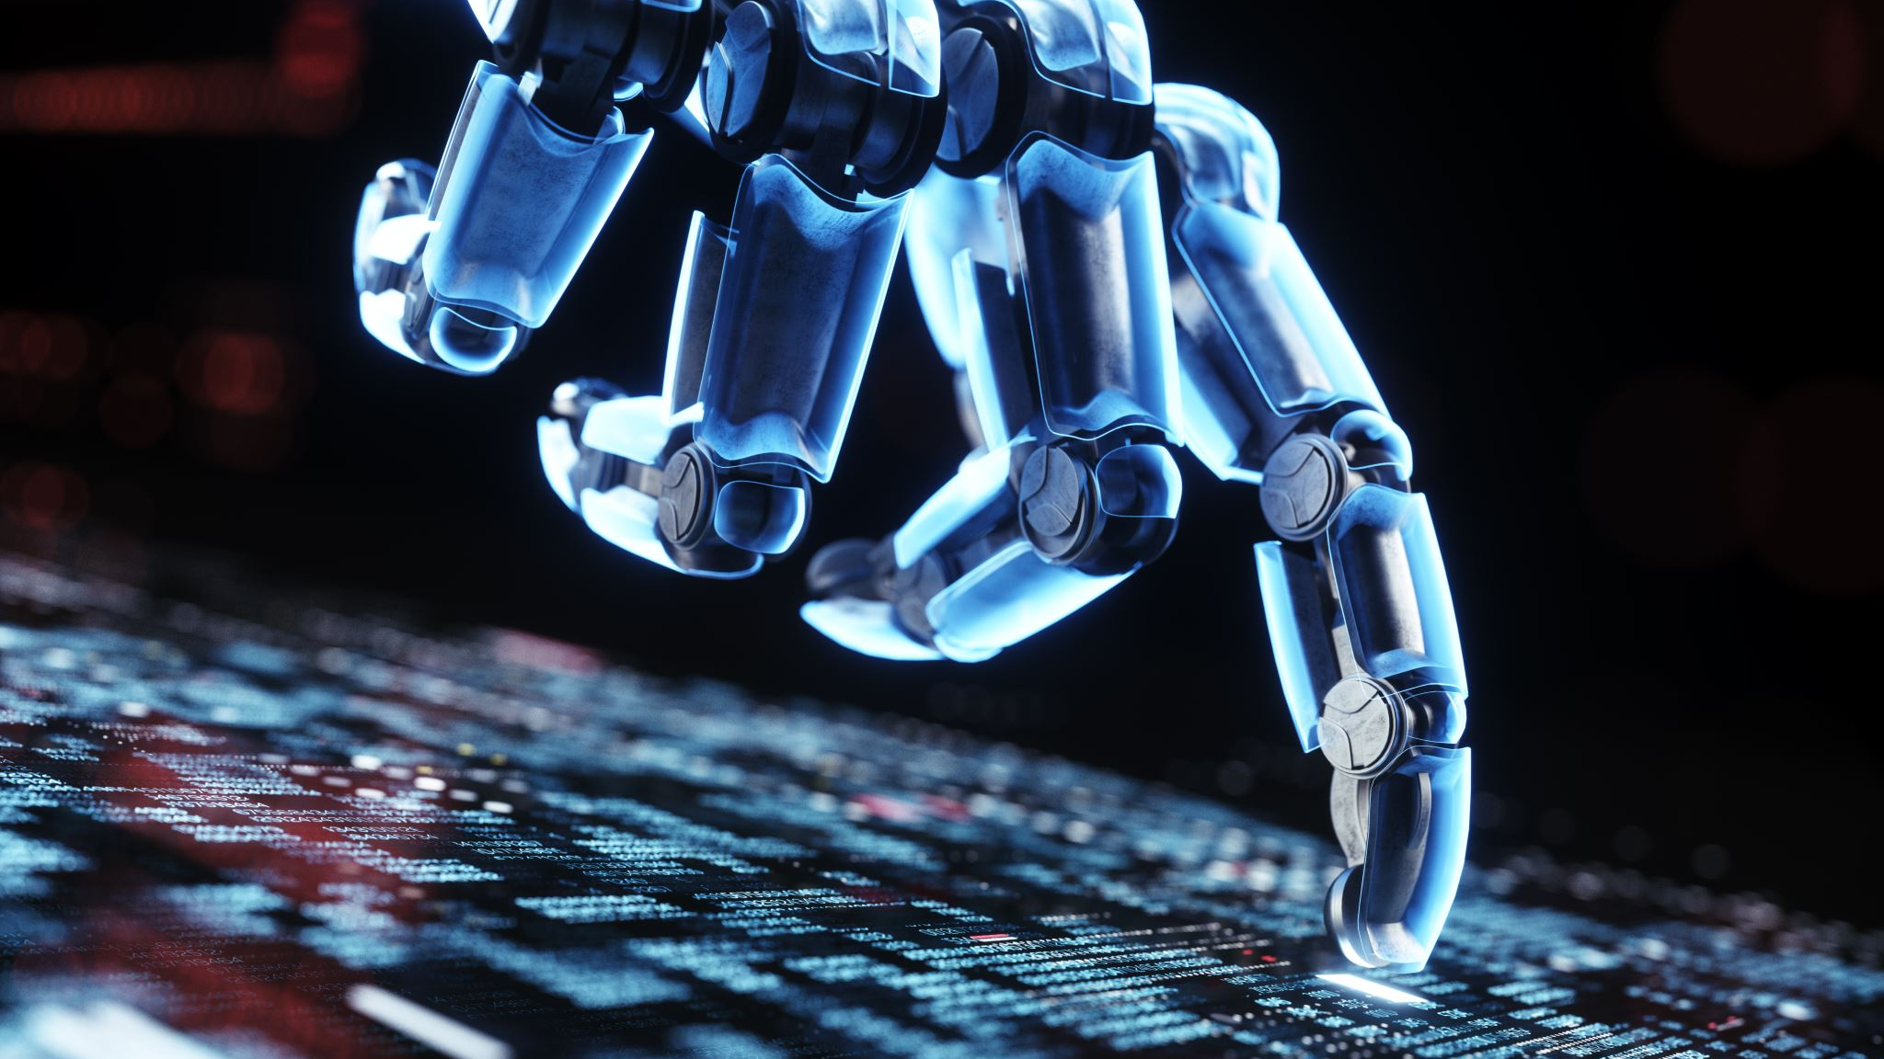
Then what is an AI ??
Any IT system that has the capability to do YOUR work !!!

Slide 5
Is the understanding correct ??

Slide 6
No..
AI is an application / solution / product that has the capability to thing and act like a HUMAN BEING…

Slide 7
Can you give some examples ……

Slide 8
Why is there so much buzz around AI now ??
Open AI + Microsoft did the unimaginable…..

Slide 9
And now everyone is running for the PIE

Slide 10
How does AI work ??

Slide 11
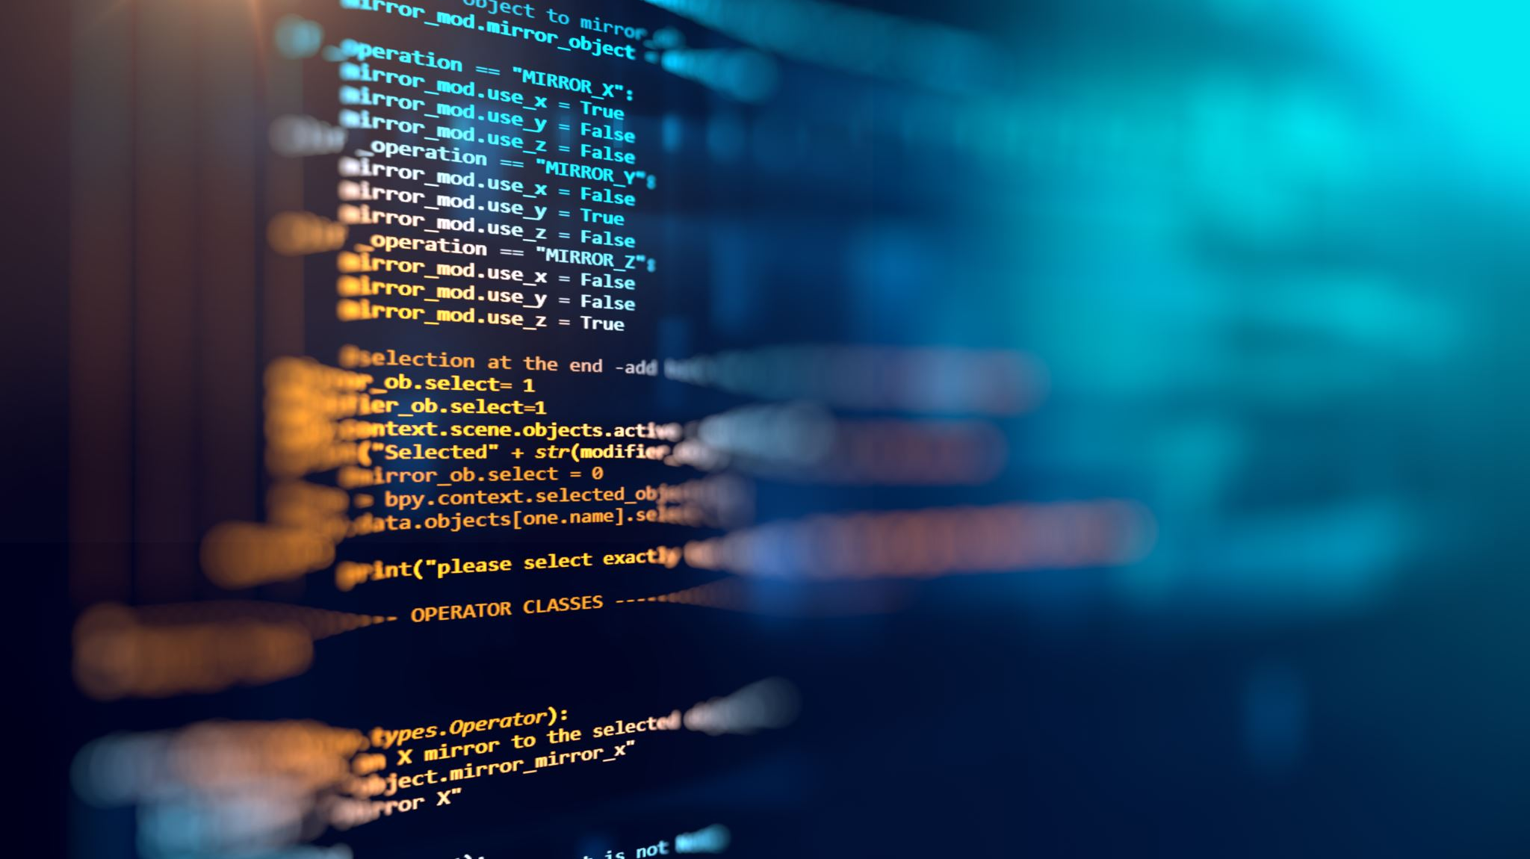
It learns from DATA

Slide 12
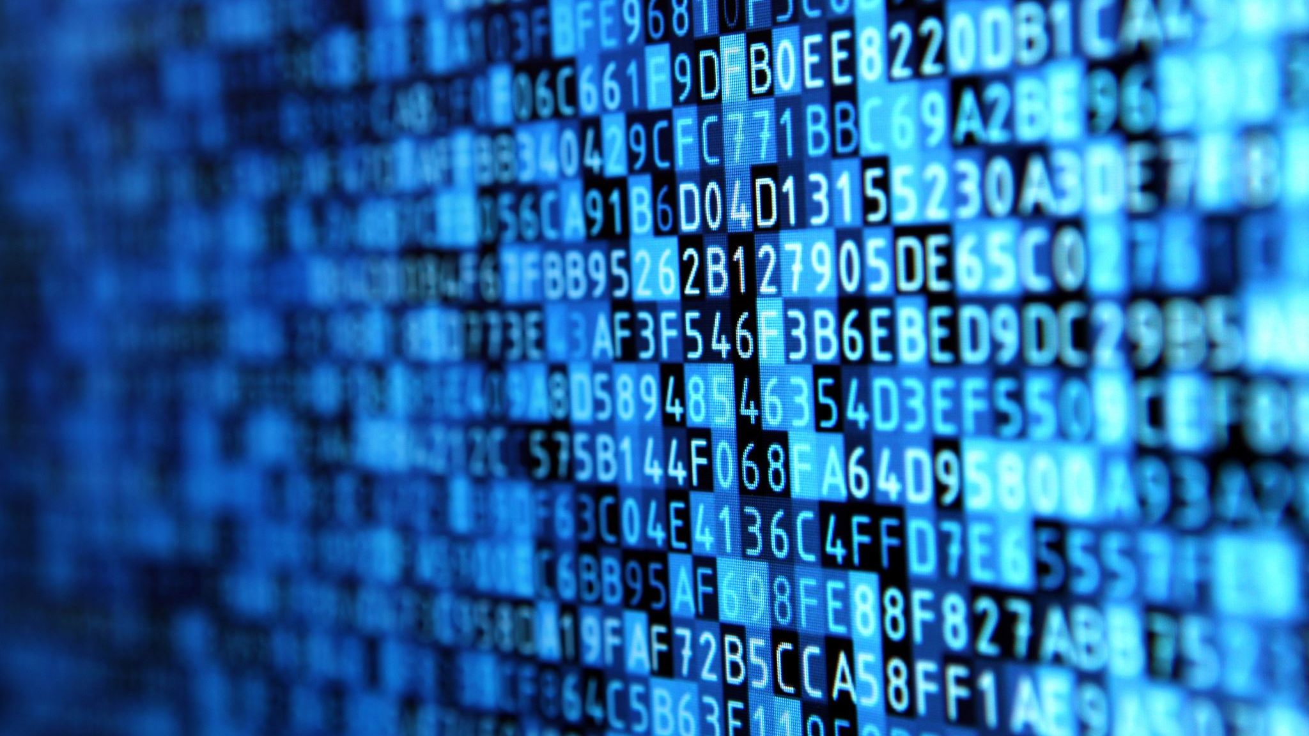
Wait.. What types of DATA

Slide 13
Numeric Data
Image Data
Textual Data

Slide 14
But how is this AI even relevant to us, Chartered Accountants ??

Slide 15
Ponder a second…

Slide 16
The entire world is experiencing the shift

Slide 17
Here is the proof…

Slide 18
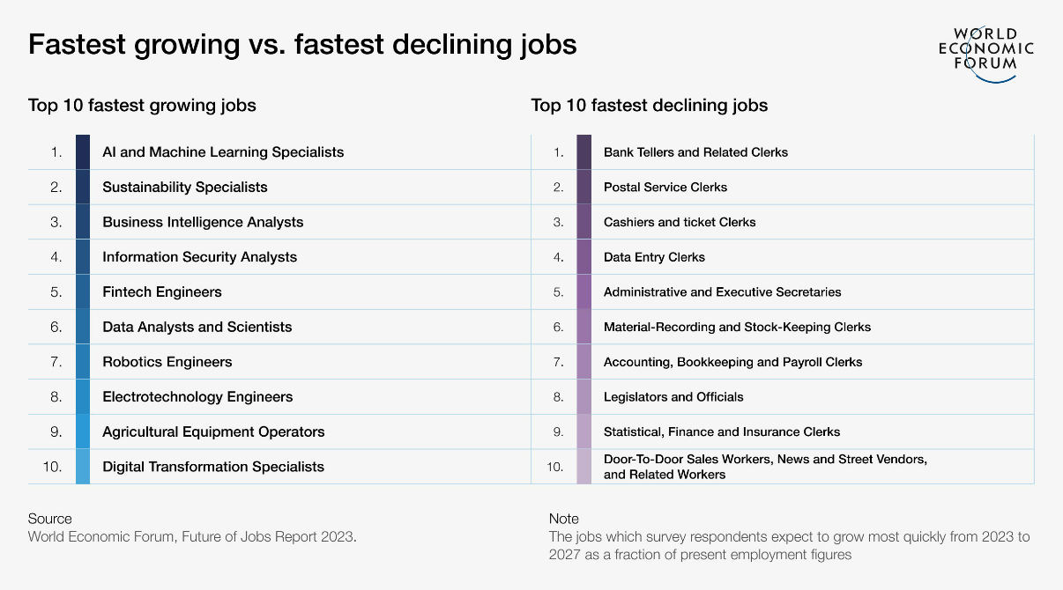
https://www3.weforum.org/docs/WEF_Future_of_Jobs_2023.pdf

Slide 19
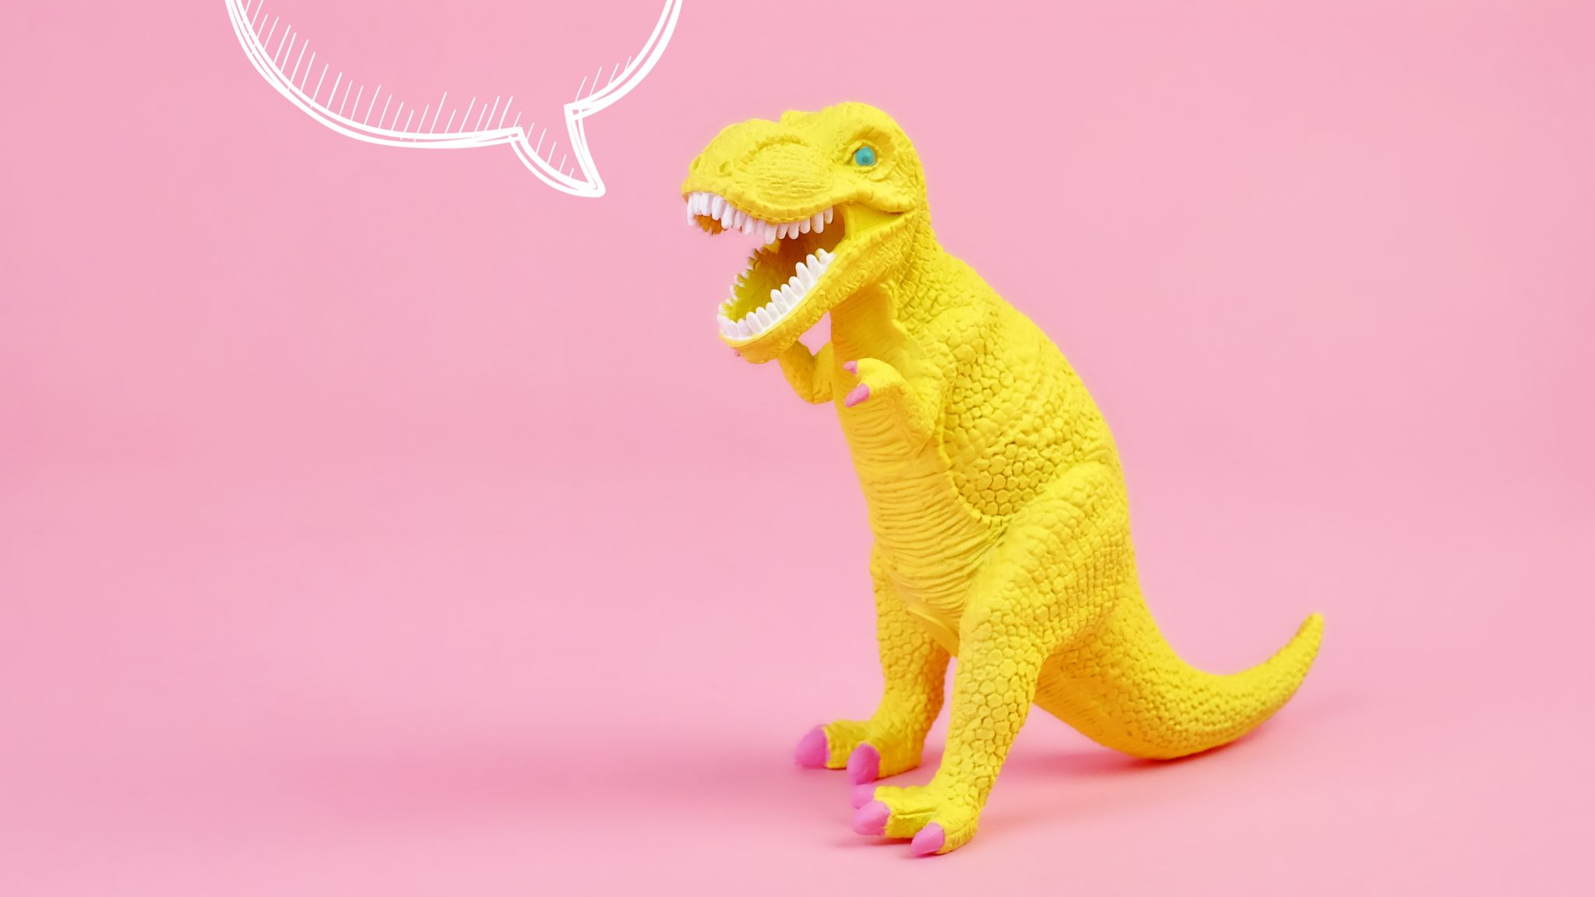
Do you want to become a Digital Dinosaur ??

Slide 20
If not.. Let’s see how you can embrace this Tsunami

Slide 21
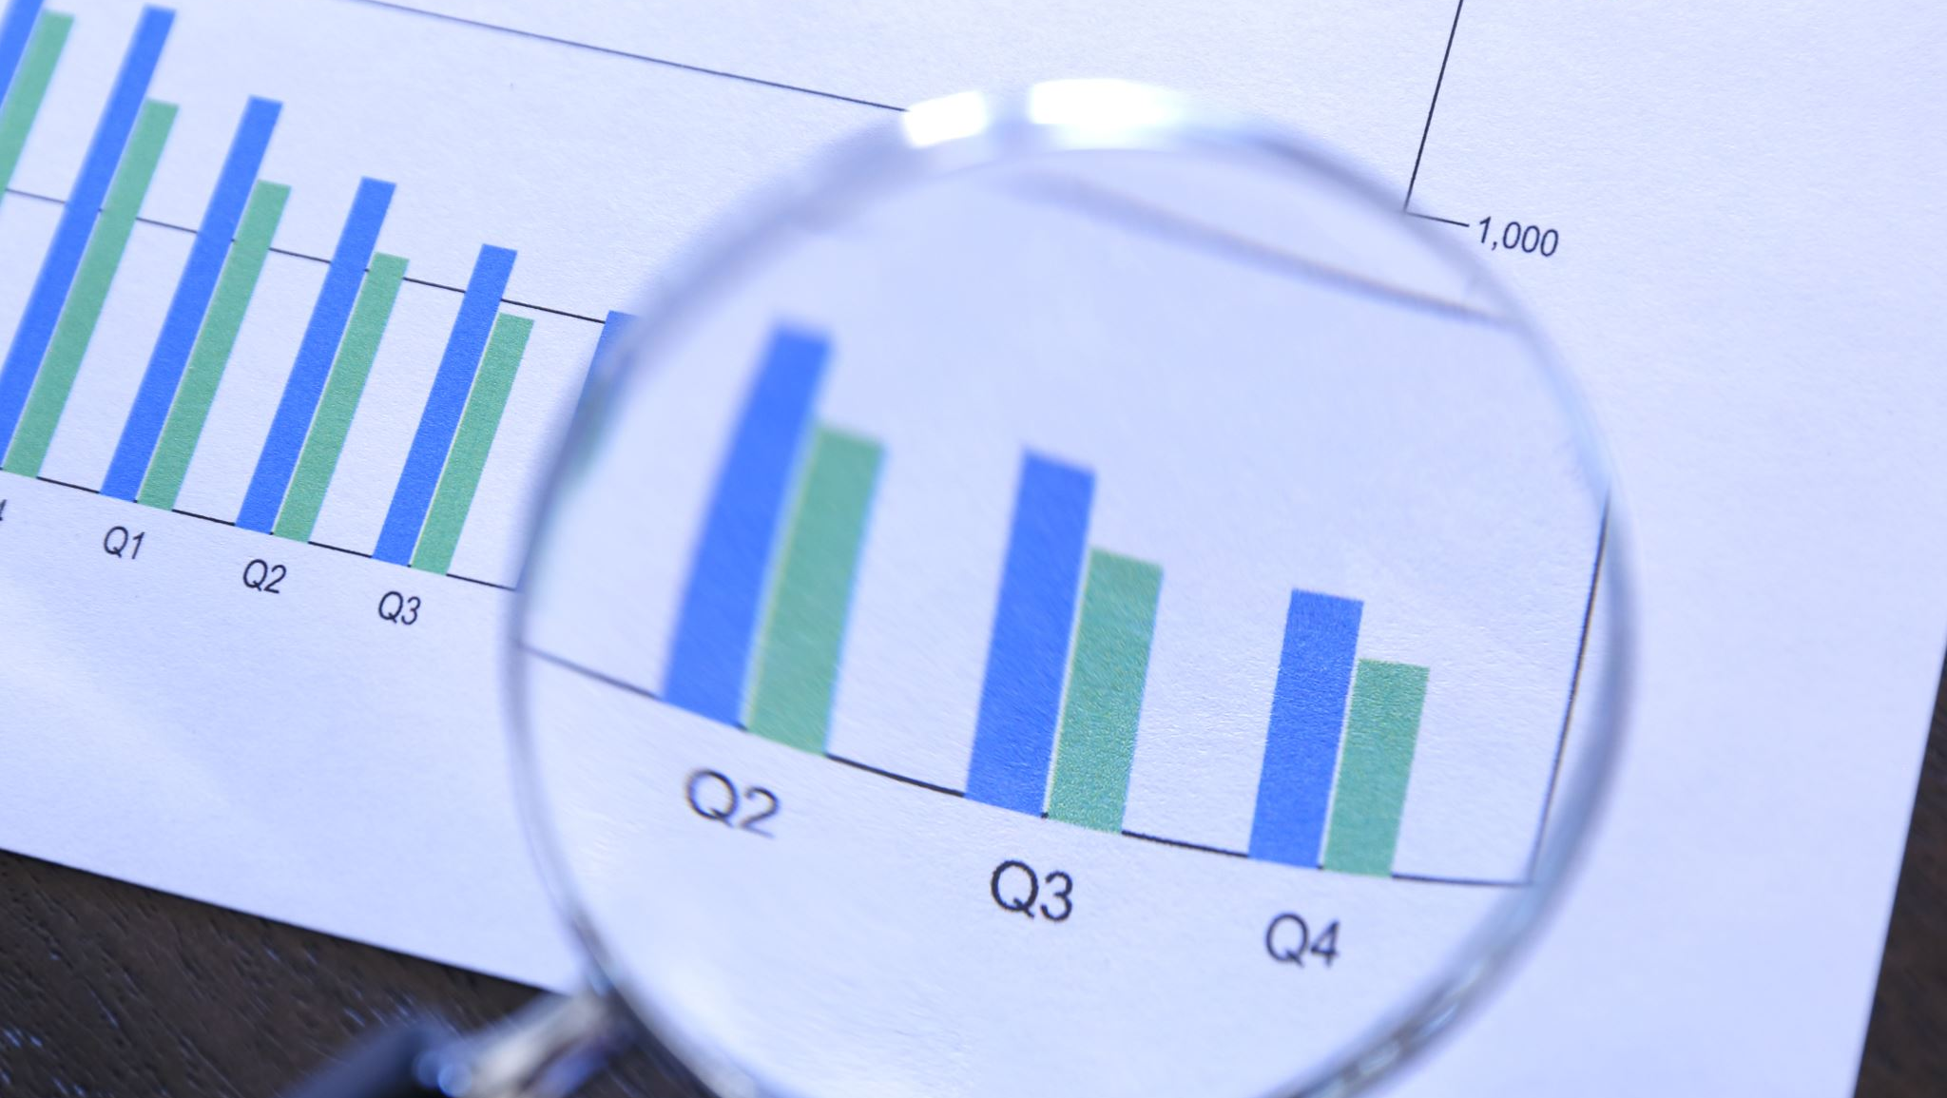
We Love Doing Audit….. 1. Stat 2. Internal

Slide 22
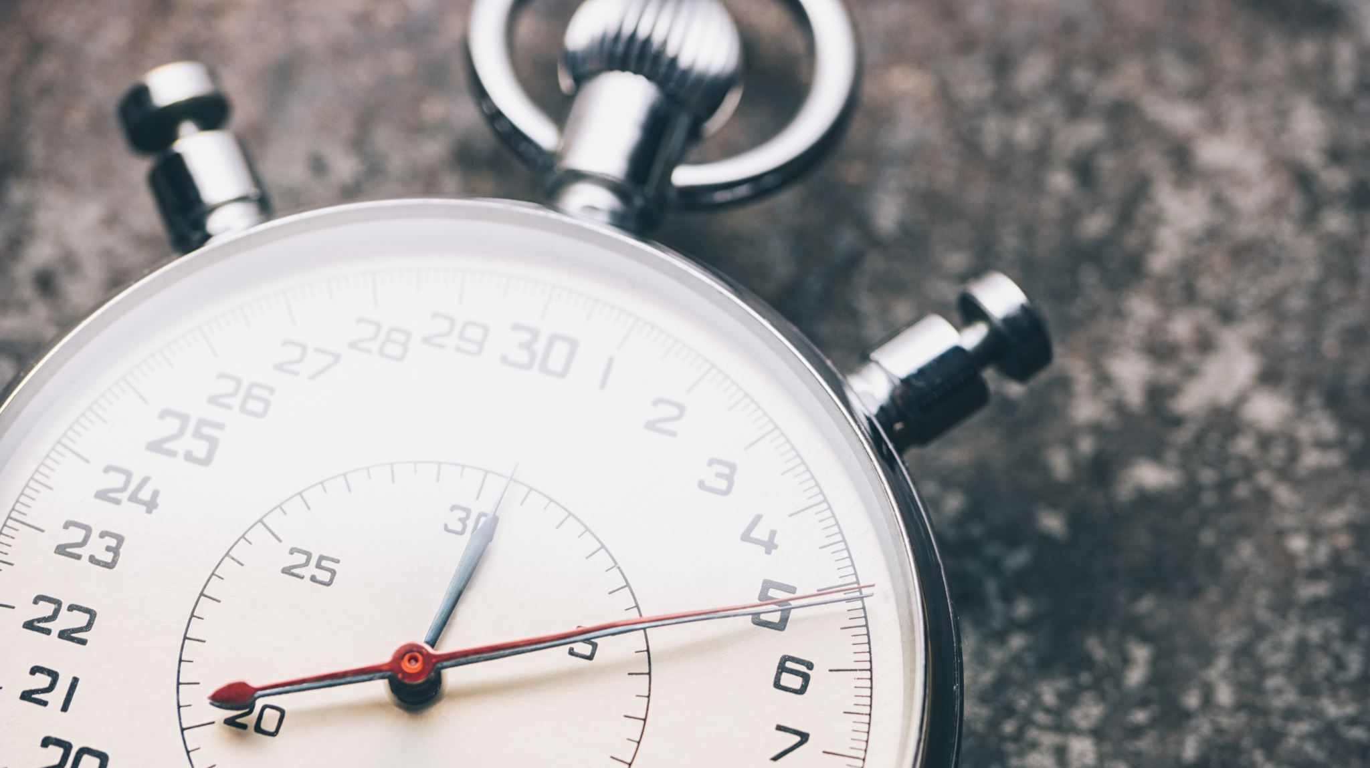
But wait.. There is something new

Slide 23
Forensic Accounting

Slide 24
How can AI be integrated in Audits??
Automated Anomaly Detection.
Predictive AI
……. This can be a proactive measure and become a Watch Dog..

Slide 25
CAs are good in Analyzing…

Slide 26
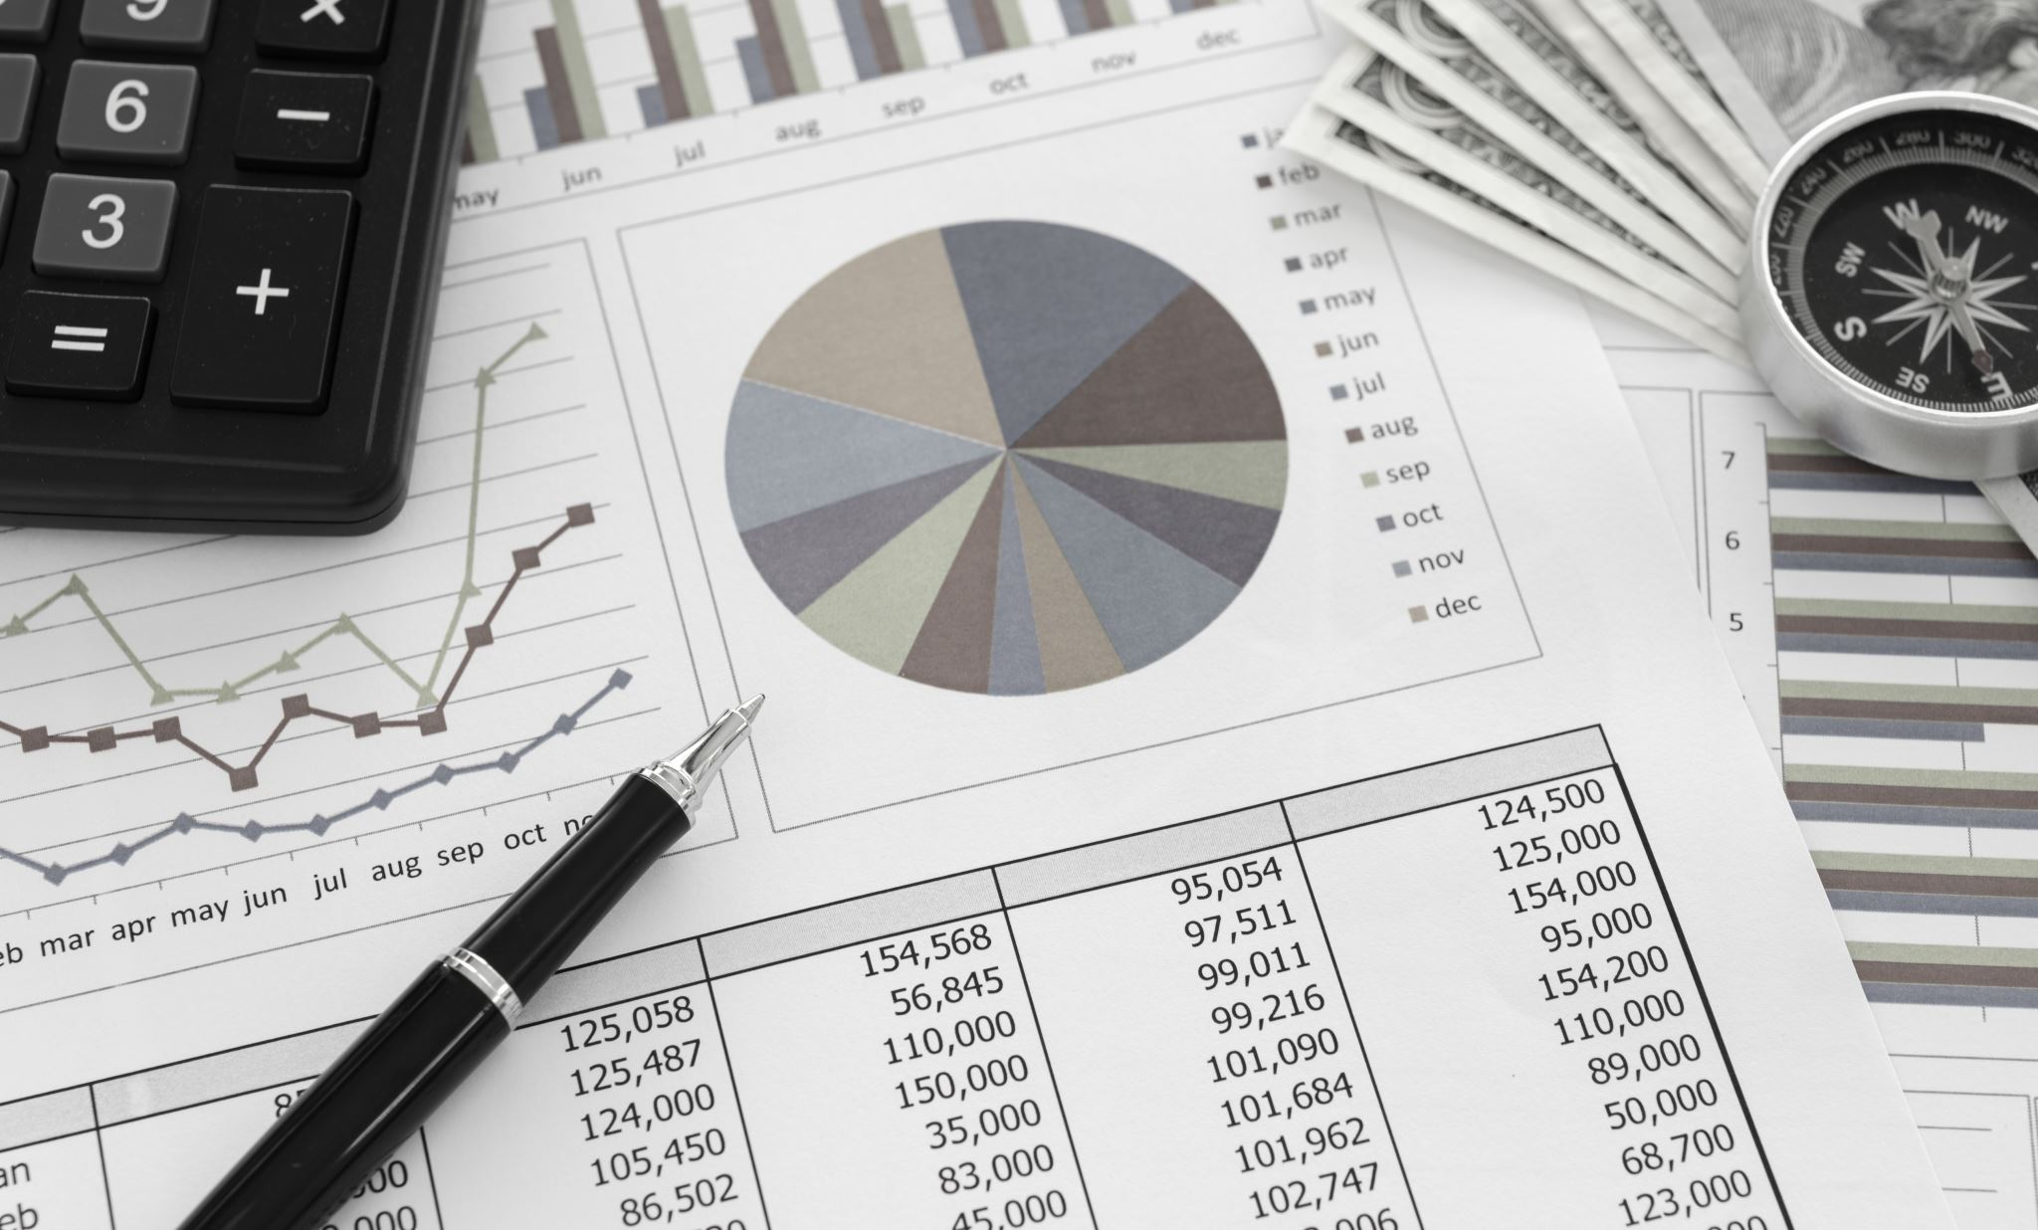
Financial Statements Analyzers

Slide 27
AI based Forecasting is changing how we have been doing projections…

Slide 28
Cash Flow Forecasting. Revenue Forecasting. Budgeting.

Slide 29
We love one more thing…

Slide 30
Why should Compliance be left behind…

Slide 31
Involves lot of documentations..

Slide 32
The GPTs (ChatGPT) can be a saviour here..

Slide 33
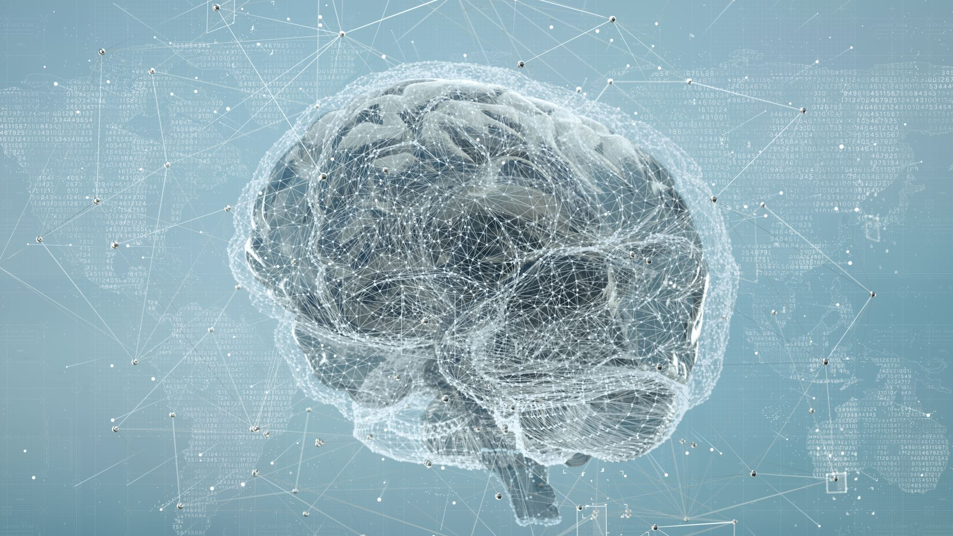
AI Based Deep Search

Slide 34
We all know Advantages…
Let’s talk about CONCERNS…

Slide 35
Data Security and Privacy

Slide 36
Job Displacement

Slide 37
AI is not going to take away your Jobs

Slide 38
But...

Slide 39
A person using AI will.

Slide 40
How can we upskill ourselves ???

Slide 41
Come out of the Compliance mindset…

Slide 42
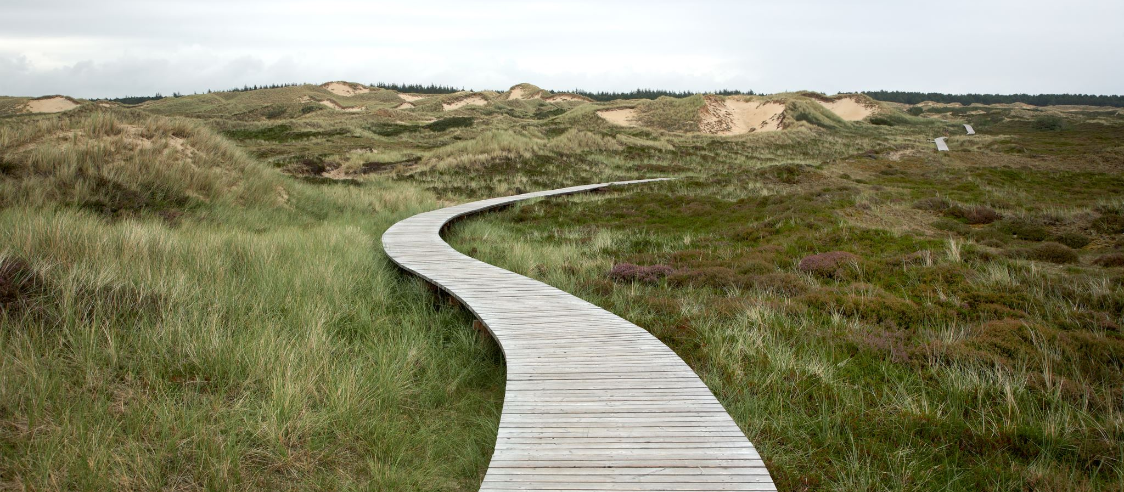
The world is moving from Compliance to Reliance..

Slide 43
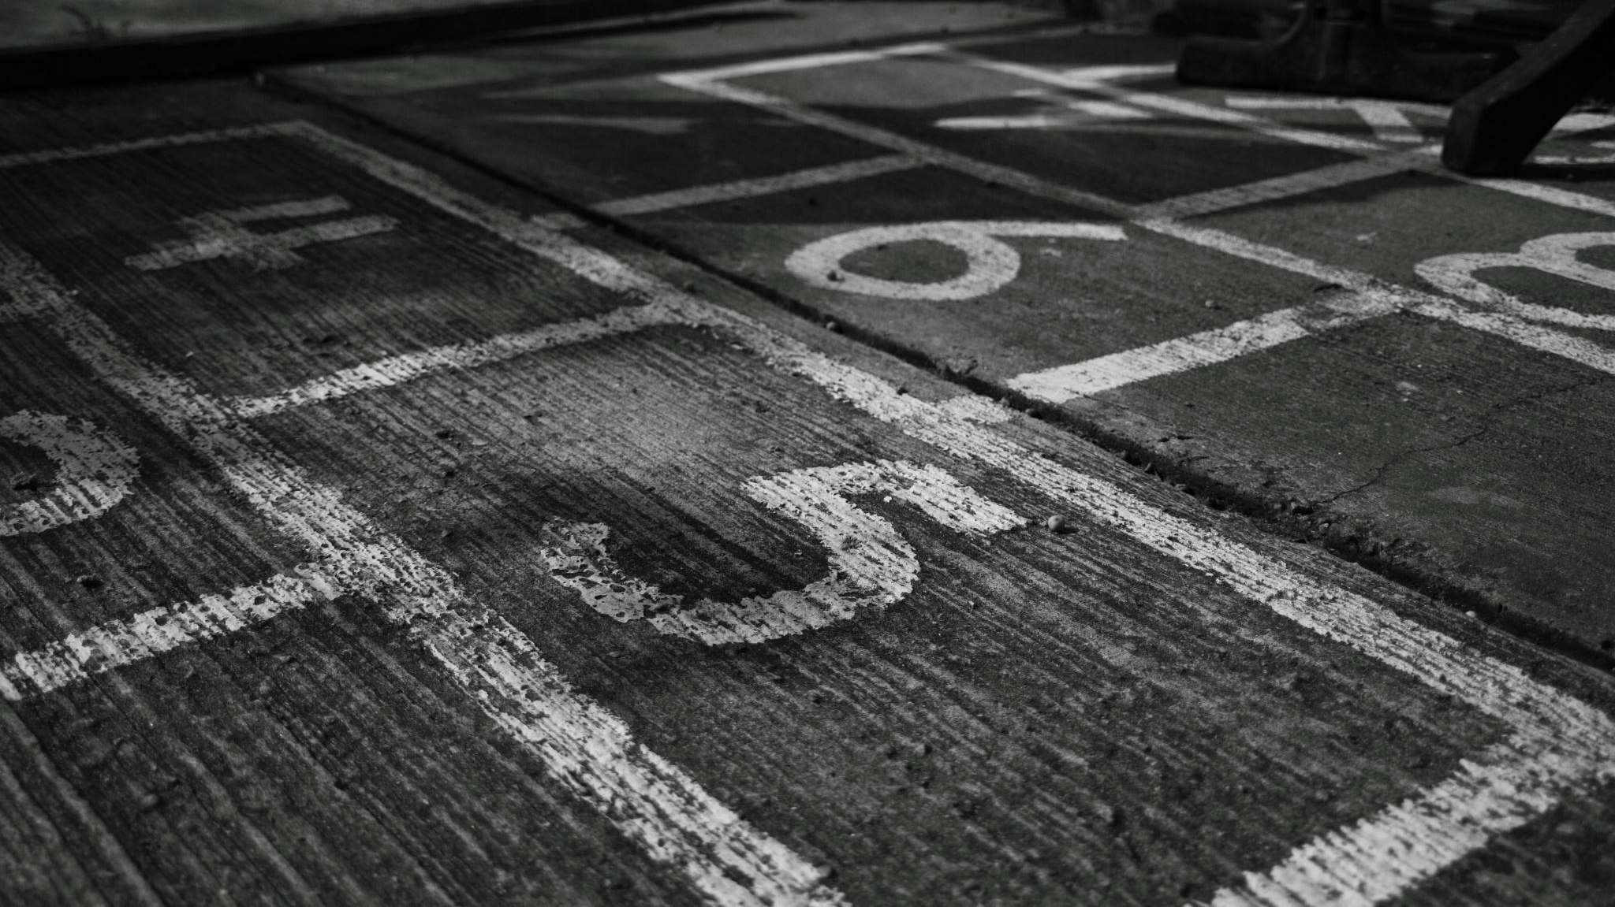
CAs are good with numbers….

Slide 44
But the time has come for us to be good at TECH as well…

Slide 45
You-Tube is the treasure.

Slide 46
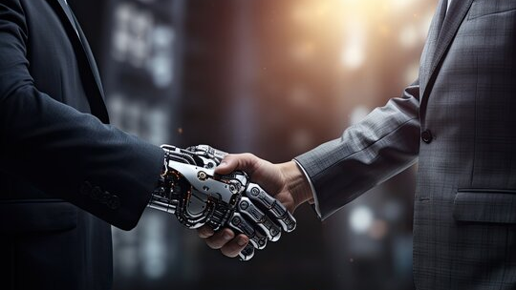
Man and Machine will Co-Exist…

Slide 47
Questions please….

